Slide 1
Loan Credit Risk Analysis
By: Ridwan Olawin,
William Wu,
Quan Ta,
Hajun Lee

Slide 2
Introduction
Credit cards are one of the most frequently used resource in countries around the world
Credit lenders have to always review the credit information of a loanee before issuing out a card
The credit information of a new loanee is almost always good at the beginning but loanees become defaulters in no short amount of time
Loanee defaulting leads to loss for credit lenders
Goal of this project is to model a way with which to let a lender know whether a potential lender would become a high-risk or low-risk defaulter

Slide 3
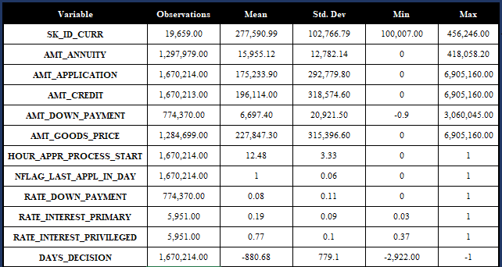
Descriptive Statistics

Slide 4
OUR PROCESS
Data Pre-Processing
Analysis and Results
Week 6-7
Week 9
Week 1-5
Week 8
Conclusion
Model implementation

Slide 5
Part1: Preprocess

Slide 6
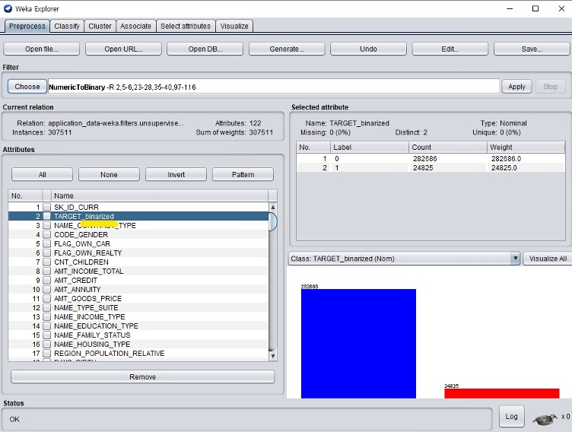
Discretizing numeric data to binary
On first look at the data, it was noted that the data type for some columns supposed to be binary were in numeric form
Approach was to use Weka’s Unsupervised attribute conversion filter
Example of a major attribute converted is the target label which is the label focused on to be predicted by our model

Slide 7
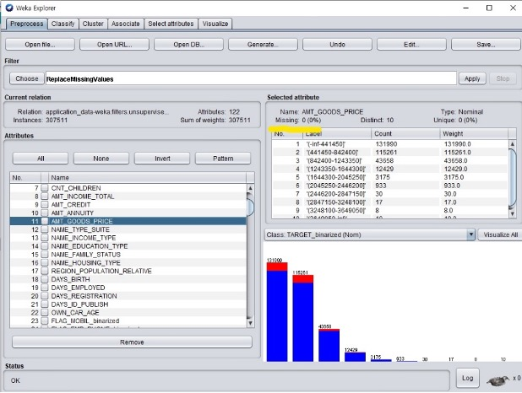
Handling missing data
After changing the numeric data type, we noticed some values were missing while looking at the descriptive statistics of different attributes.
For example, we noticed the AMT_GOODS_PRICE attribute had about 1% of its values missing
Approach was to use Weka’s unsupervised replacemissingvalues filter on the different attributes with missing values.
What the weka approach did was to replace the missing rows with averages and modes of the column as a whole based on certain constraints

Slide 8
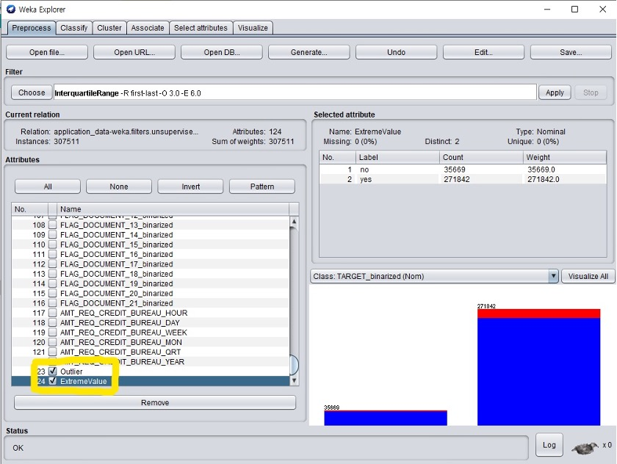
Removing Outliers and Extreme Values
After handling the missing data, we decided to remove outliers and extreme values from our data.
This step had to be done before discretizing numeric data into nominal ones.
We used Weka’s Interquartile Filter that produced attribute “outlier” and “extreme values”. Then, we used “RemoveWithValues” Filter to remove them.

Slide 9
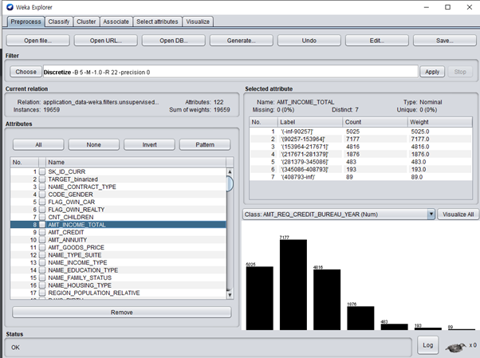
Discretizing Numeric to Nominal
After handling missing data and removing outliers and extreme values, we now discretize the numeric data into nominal ones.
Discretizing numeric data into bins would help us analyze our data more efficiently than using the continuous values.
This is done by using “Discretize” filter from Weka’s Unsupervised Attribute section.
We choose the “binRangePrecision” to be 0, so that we do not get decimal values, and select 7 bins.

Slide 10
Part 2: Model Implementation

Slide 11

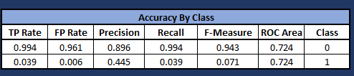

Algorithm 1: Logistic Regression

Slide 12



Algorithm 2: Decision Tree

Slide 13






Algorithm 3: KNN
K = 5
K = 10

Slide 14



Algorithm 4: Naive Bayes

Slide 15
Part 3: Model Analysis

Slide 16
Algorithm 1: Logistic Regression
Logistic regression resulted in similar results to the majority of others algorithms
Correctly classified instances (CCI) metric is at the same level as decision tree and Knn at around 89% (89.2212%)
True Positive Rate (TP Rate) is close to 100% (99.4%)
ROC Area is the highest of all the test (87.2%)
The accuracy for evaluating precision, recall and F-Measure for Class 0 (low risk transaction) is high
The accuracy for Class 1 (high risk transaction) is much lower
May caused by small sample size

Slide 17
Algorithm 2: Decision Tree
Since our dataset consist mainly nominal data, we decide to use decision tree as it works best here
Decision tree resulted in similar results to the majority of others algorithms
CCI is around 89% (89.2873%)
True Positive Rate is close to 100% (99.4%)
The accuracy for evaluating precision, recall and F-Measure for Class 0 (low risk transaction) is high
The accuracy for Class 1 (high risk transaction) is much lower
May caused by small sample size

Slide 18
Algorithm 3: KNN
In high risk fraudulent credit transaction, KNN allows us to classify an incoming transaction by calculating a nearest point to new incoming transaction
Since we are working with a large dataset, we decided to use a large k-value to reduce the effect of a noisy dataset
k = 5
CCI is around 88% (88.3667%)
TP Rate is around 98% (98.6%)
k = 10
CCI is around 89% (89.2619%)
TP Rate nearly 100% (99.9%)
The result of testing with k = 10 is consistent with results in decision tree and logistic regression except for ROC Area
k > 10
The results for tests where k goes beyond 10 makes less sense

Slide 19
Algorithm 4: Naive Bayes
Naive Bayes works best with an almost large training dataset
Naive Bayes result is the most insignificant and inaccurate of all the tests conducted
CCI is below 70% (69.23%) and significantly lower than other test results (88-89%)
TP Rate is much lower as well (70.4%) in comparison to other test (98-99%)
The accuracy for evaluating recall (0.593) and F-Measure (0.292) for Class 1 are significantly higher than those in other tests
In other tests, class 1’s recall ranges from 0.02 to 0.039 and its F-measure ranges from 0.04 to 0.073

Slide 20
Conclusion
Common issue found in datasets that are used for classification is imbalance classes issue
Refers to a classification problem where the number of observation per class is not equally distributed
Reflects an unequal distribution of classes within a dataset
In a balanced data, if there are 2 classes then 50% points for each of the classes
In our case, there was a 50:1 ratio between high-risk and low-risk classes which indicated significant imbalance
Hence, the best classifying algorithm to model our data would be Decision Tree due to the extensive advantages it had on our pre-processed data
Exploratory analysis allowed us to understand and process the data correctly

